Slide 1

Web programming – Project 1
SHRIYA VELURU
MOUNIKA KODURI
AVINASH GOLI

Slide 2
MURDER THE MONSTER
Game demo -
UX design – Mounika
CSS animations and transformations – Avinash
Linking it to the HTML and Testing the Visual Implementation - Shriya

Slide 3
UX design
Since it is a game to Murder the monster, we thought of having a dark and gloomy background.
And thought that it'll be dramatic if we add the Thundering effect as well.
And we thought of having a score card for each kill at the Top right corner - since it is a kill thought of having the text color as RED. And we have added a timer of 5seconds within which we have to finish the game by killing maximum number of monsters.
And the title of the game should be brought up using a different font other than regular one – Google fonts API.

Slide 4
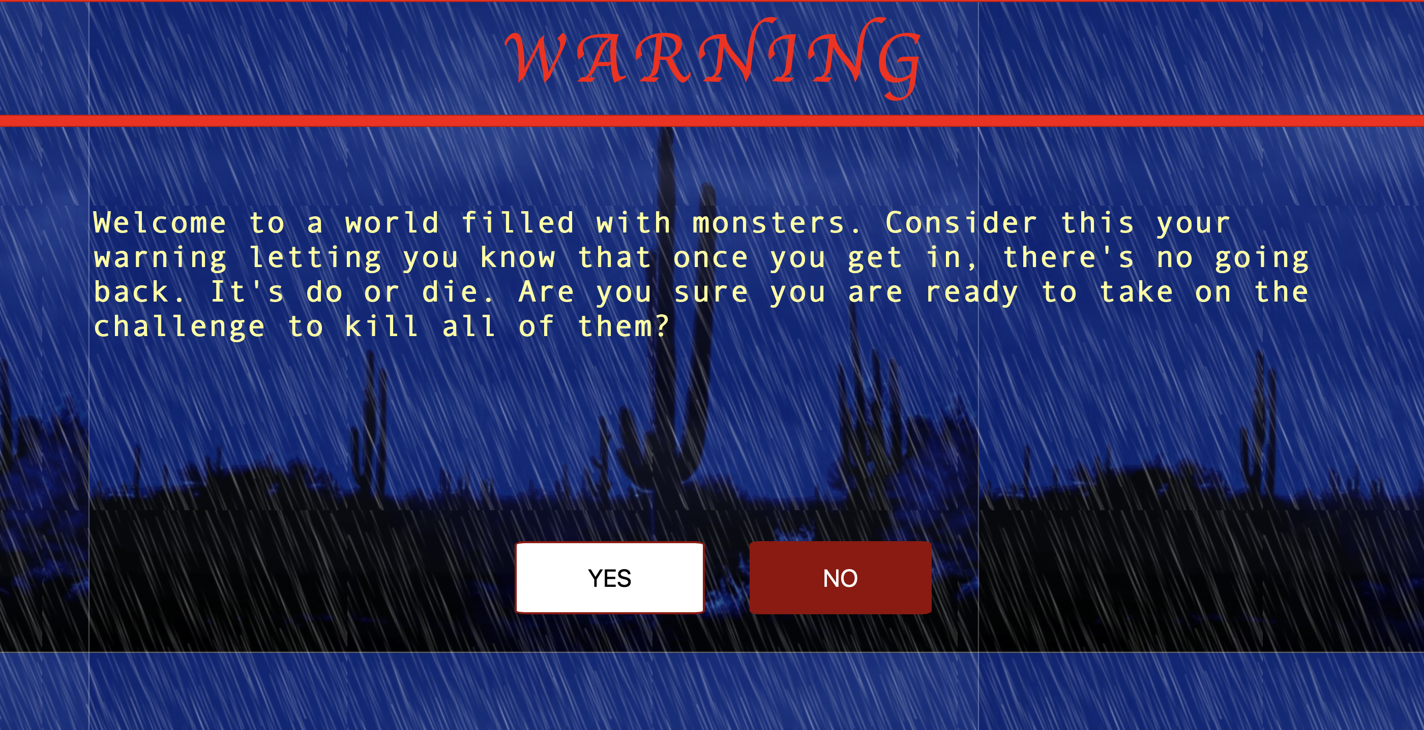
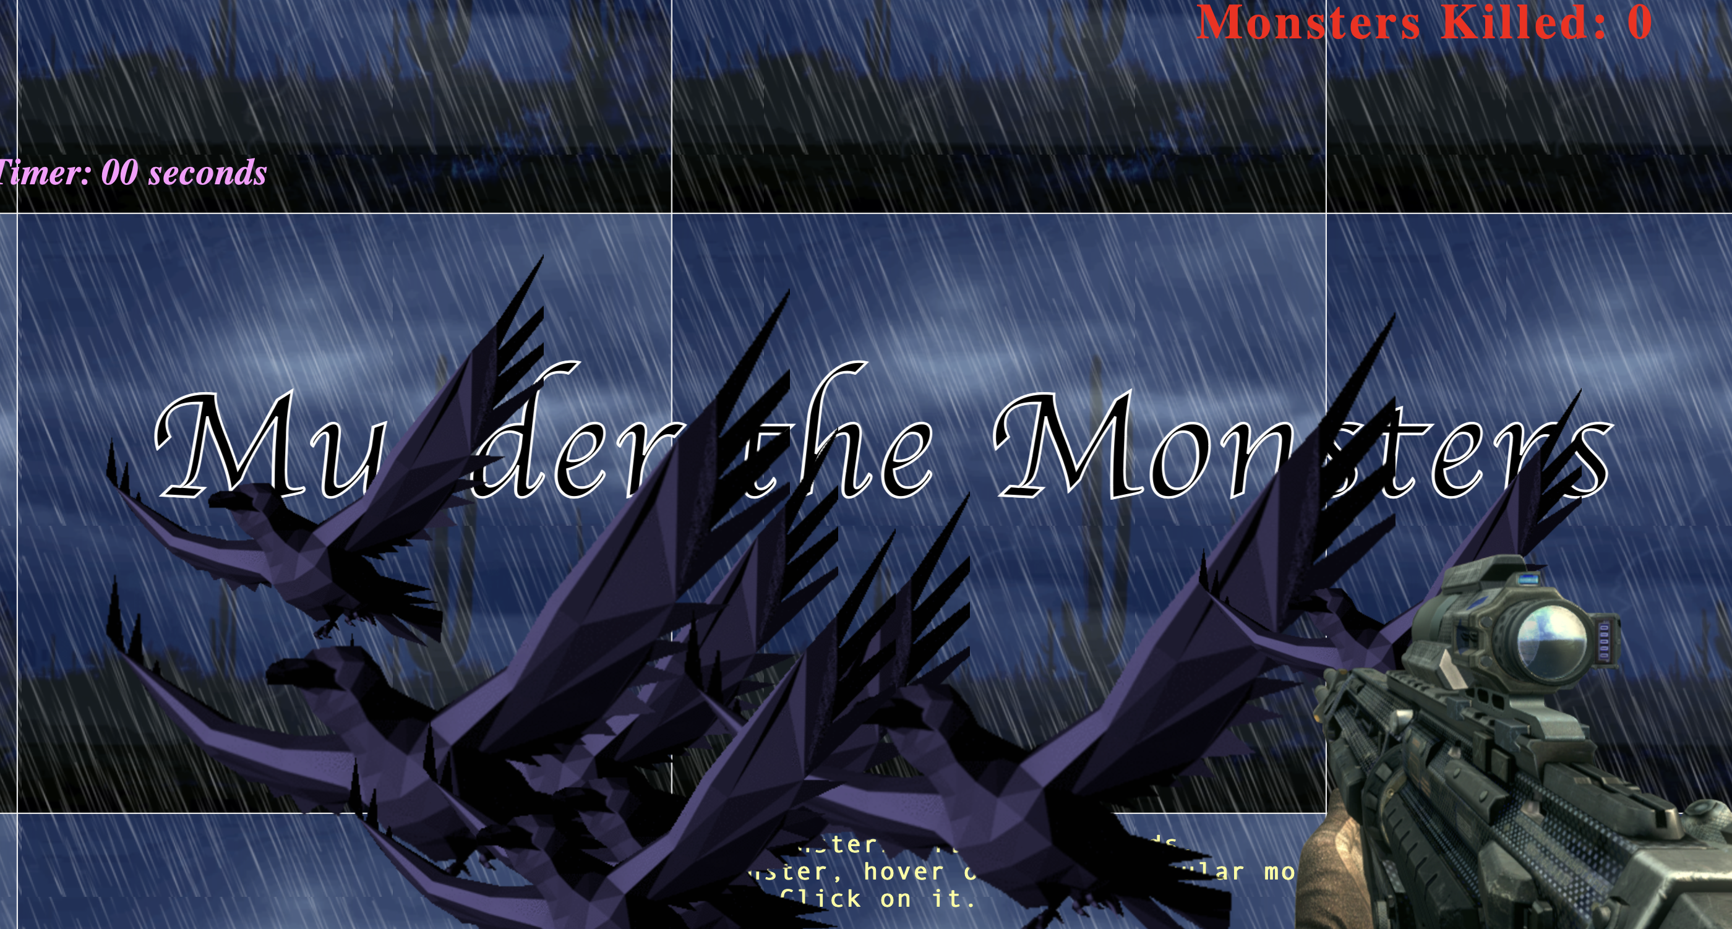
Homepage
The project is comprised of two web pages. The homepage serves to provide a detailed description of the game, while also offering two clickable buttons to proceed with either "yes" or "no." Upon selecting the "yes" button, users are then redirected to the demo page where they will be able to witness a range of CSS transformations in action.

Slide 5
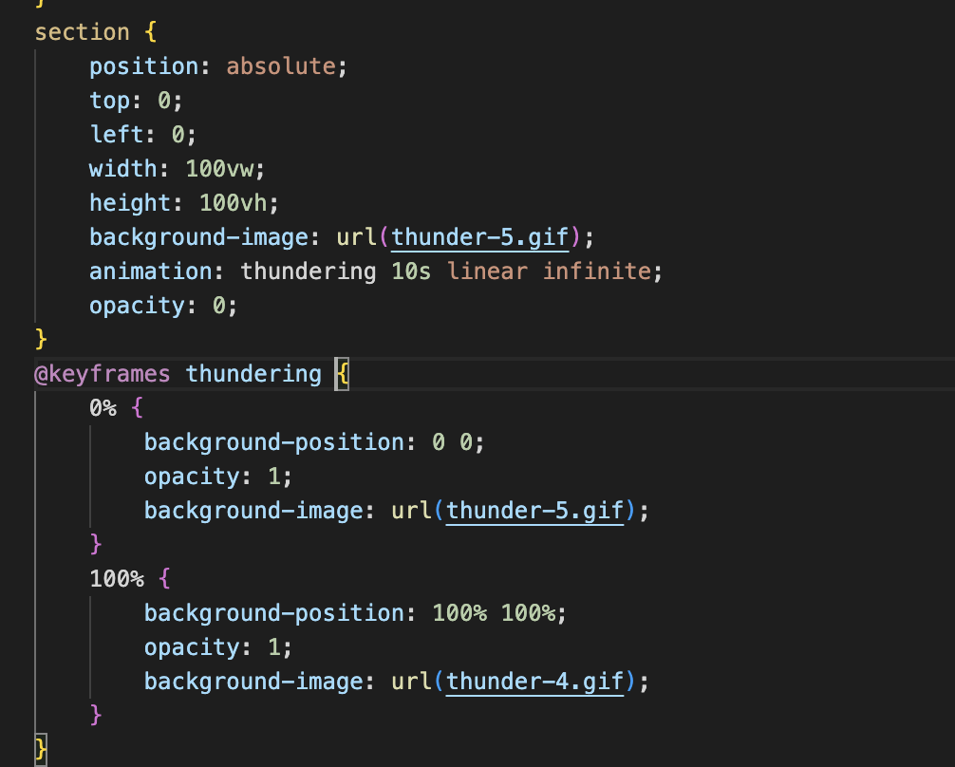
Background
The section selector is used to create a full-screen background image of a thunderstorm with a background-image property.
The position: absolute property is used to position the section element at the top left corner of the screen. The width: 100vw and height: 100vh properties are used to set the width and height of the element to the full size of the viewport. The animation property is used to apply a thundering animation with a duration of 10 seconds and a linear animation timing function, which loops infinitely.
The @keyframes rule defines the animation. The 0% keyframe sets the initial position and opacity of the section element. The 100% keyframe sets the final position and opacity of the section element.

Slide 6
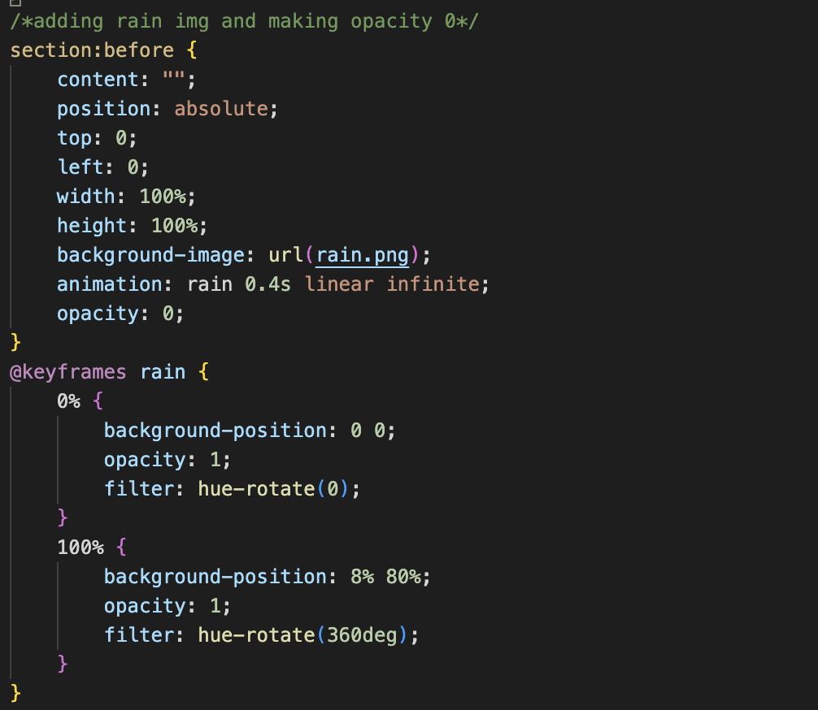
Rain effect
The “section:before” pseudo-element is used to create a new element as the first child of the <section> element. This element is absolutely positioned over the entire section element and set to have a background image of the raindrops.
The opacity property is set to 0 initially, so the rain is not visible until the opacity is animated to 1 using the @keyframes rain animation.
The @keyframes rain animation has two keyframes, one at 0% and another at 100%. At 0%, the background-position property is set to 0 0, which means the image is positioned at the top left corner of the element. The opacity property is set to 1 and the filter property is set to hue-rotate(0), which means the color of the rain is not changed.
At 100%, the background-position property is set to 8% 80%, which means the image is positioned at 8% from the left and 80% from the top of the element. The opacity property is still 1, and the filter property is set to hue-rotate(360deg), which means the color of the rain is rotated by 360 degrees, giving it a different color.

Slide 7
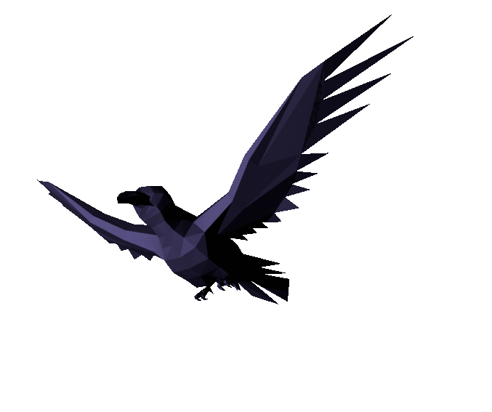
Monsters
Now all we need are some “Monsters" flying around in the dark.
Tried some gifs of different ghosts from internet and finally fixed on the below gif to make our game more interesting.
Initially, this gif was having a colored background color, we used an online tool to remove the background of this gif completely.

Slide 8
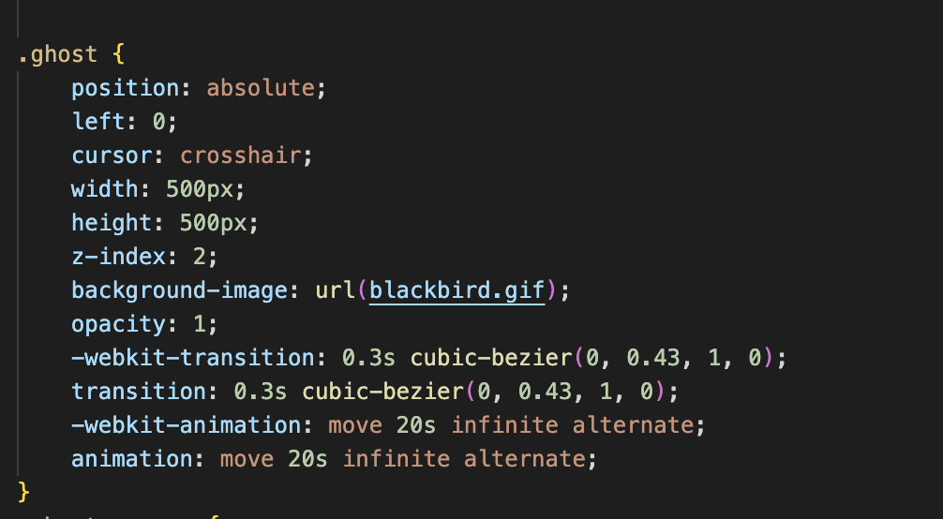
Movement of the Monsters
The width and height properties are set to 500px to set the size of the element, and the z-index property is set to 2 to bring the element in front of the other elements.
The -webkit-transition and transition properties are used to create a smooth transition between the states of the element. The -webkit-animation and animation properties are used to apply the movement animation to the elements with a duration of 20 seconds and an infinite number of loops.

Slide 9
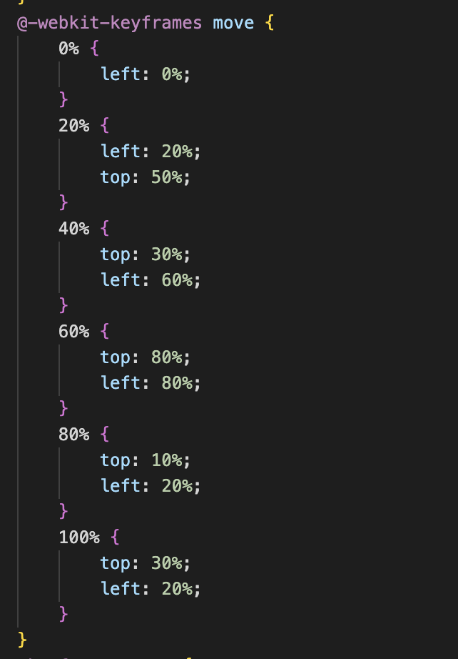
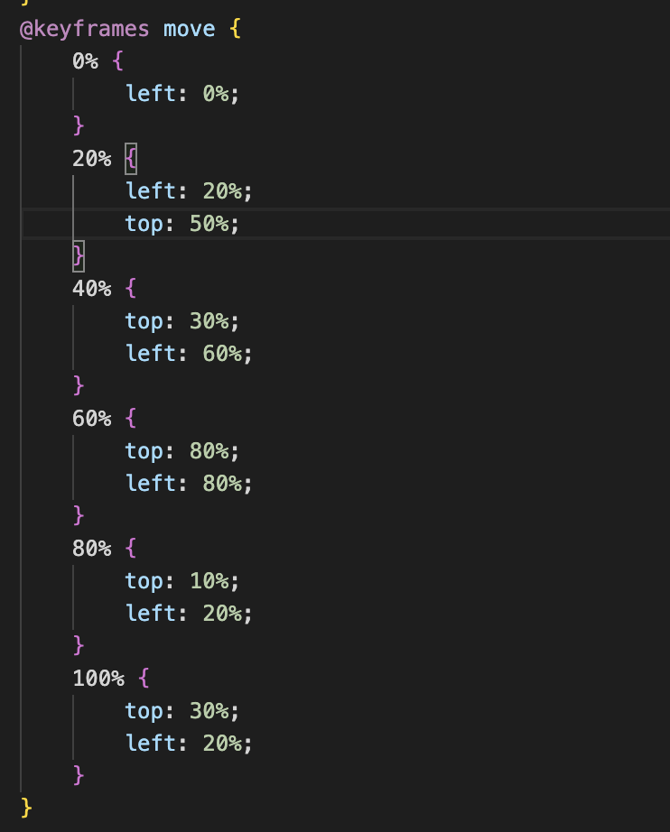
Continue...
There are two keyframes defined: move and -webkit-move. These two keyframes are identical, except for the vendor prefix -webkit- which is used to ensure compatibility with older versions of webkit browsers (such as Safari and Chrome).
The animation starts with the ghost images moving from the left of the screen to the right, then down, then across to the right again, and so on. The 100% value for each keyframe is the final position of the ghost image.
Once the animation completes, the ghost images loop back to the beginning and repeat the animation infinitely.

Slide 10
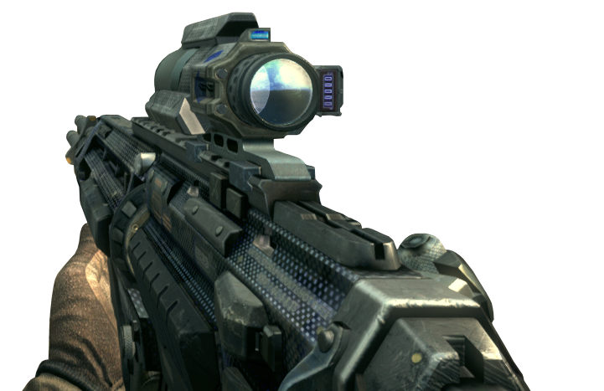
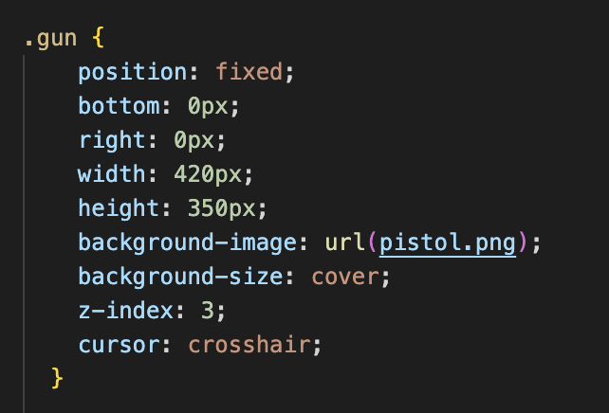
Gun
The .gun selector is used to style the gun image, which is fixed to the bottom right corner of the screen. The background-image property is used to set the gun image, and the cursor property is set to crosshair to indicate that it is a targeting cursor.

Slide 11

Thank you !
Any Questions?

